Slide 1

Modern Database Management
Thirteenth Edition
Chapter 6
Advanced S Q L
Copyright © 2019, 2016, 2013 Pearson Education, Inc. All Rights Reserved
Notes:
If this PowerPoint presentation contains mathematical equations, you may need to check that your computer has the following installed:
1) MathType Plugin
2) Math Player (free versions available)
3) NVDA Reader (free versions available)

Slide 2
Learning Objectives
6.1 Define terms
6.2 Write single- and multiple-table queries using S Q L commands
6.3 Define three types of join commands and use S Q L to write these commands
6.4 Write noncorrelated and correlated subqueries and know when to write each
6.5 Write queries to create dynamic and materialized views
6.6 Understand common uses of database triggers and stored procedures
6.7 Discuss the S Q L:2011 and S Q L:2016 standards and explain S Q L enhancements and extensions

Slide 3
Processing Multiple Tables (1 of 2)
Join
A relational operation that causes two or more tables with a common domain to be combined into a single table or view
Equi-join
A join in which the joining condition is based on equality between values in the common columns; common columns appear redundantly in the result table
Natural (inner) join
An equi-join in which one of the duplicate columns is eliminated in the result table
Notes:
Very often the data we want to see from a query needs to come from multiple tables. Most of the time these tables are linked in relationships via primary and foreign keys to implement 1:N relationships. The vast majority of joins involve matching primary and foreign keys, but there can also be other kinds of joins as well.

Slide 4
Processing Multiple Tables (2 of 2)
Outer join
A join in which rows that do not have matching values in common columns are nonetheless included in the result table (as opposed to inner join, in which rows must have matching values in order to appear in the result table)
Union join
Includes all data from each table that was joined
Notes:
Unions are not literally joins, and the syntax for expressing a union is not the same as the syntax for expressing a join. Nevertheless, unions also combine data from different tables.

Slide 5
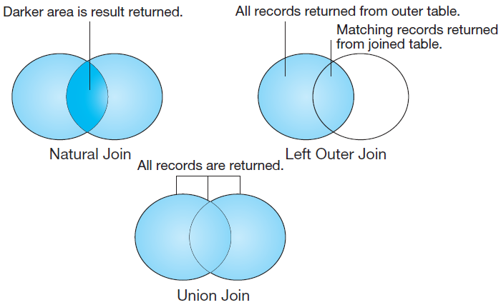
Figure 7-2 Visualization of Different Join Types with Results Returned in Shaded Area
Notes:
In this Venn diagram, the data from each table is represented as a circle. Natural joins will only return the records from each table that have a match in the join condition with the other table. This is also called an inner join. By contrast, with an outer join, the records from one table will be included even if there are no corresponding records from the other. With a union join, all records from both tables are returned. This can also be accomplished via a full outer join.

Slide 6
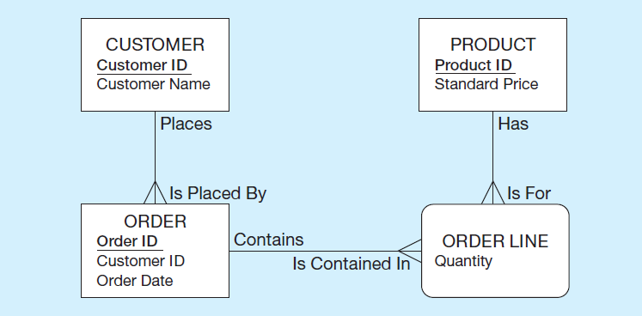
The Following Slides Create Tables for This Enterprise Data Model
(from Chapter 1, Figure 1-3)
Notes:
This is the E-R diagram from Chapter 1. Each of these entities, including the associative entity, is implemented as a table in the database.

Slide 7
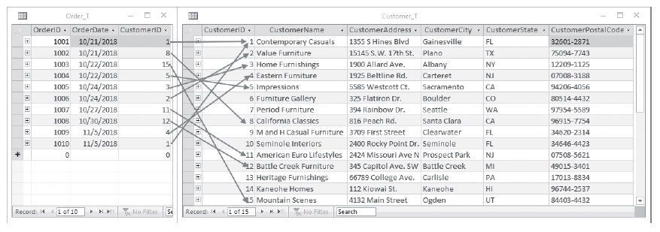
Figure 6-1 P V F Company Customer_T and Order_T Tables
With pointers from orders to the customers who placed them
Notes:
Customer_T and Order_T have a 1:N relationship, as you can see from the CustomerID foreign key in Order_T. These are two of the tables; the others are OrderLine_T and Product_T.
Order_T has a foreign key called CustomerID. This foreign key references the Customer_T table’s primary key, also called CustomerID.
These tables are used in the queries that follow.

Slide 8
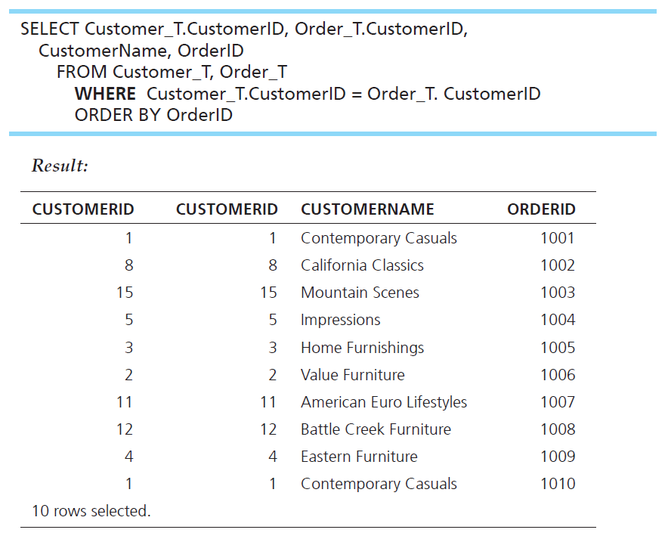
Equi-Join Example
What are the customer I Ds and names of all customers, along with the order I Ds for all the orders they have placed?
Notes:
This is an equi-join. Notice that the CustomerID is showing from both tables. It’s probably not necessary to see this, because they are always matched.
Notice also that 10 rows are returned in this query. There are 10 rows in the Order_T table, and only those rows from the Customer_T table with corresponding orders will be included. That’s because equi-joins are inner join by default.
The query:
SELECT Customer_T.CustomerID, Order_T.CustomerID, CustomerName, OrderID
FROM Customer_T, Order_T
WHERE Customer_T.CustomerID = Order_T. CustomerID
ORDER BY OrderID
The results:
CUSTOMERID CUSTOMERID CUSTOMERNAME ORDERID
1 1 Contemporary Casuals 1001
8 8 California Classics 1002
15 15 Mountain Scenes 1003
5 5 Impressions 1004
3 3 Home Furnishings 1005
2 2 Value Furniture 1006
11 11 American Euro Lifestyles 1007
12 12 Battle Creek Furniture 1008
4 4 Eastern Furniture 1009
1 1 Contemporary Casuals 1010
10 rows selected.

Slide 9
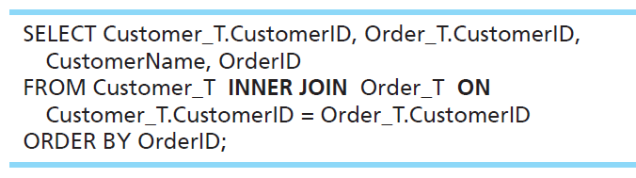
Equi-Join Example – Alternative Syntax An INNER Join
INNER JOIN clause is an alternative to WHERE clause, and is used to match primary and foreign keys.
An INNER join will only return rows from each table that have matching rows in the other.
This query produces the same results as the previous equi-join example.
Notes:
For join conditions, sometimes this syntax is used instead of the WHERE clause. This way you can distinguish between conditions that are used for matching records between tables vs. conditions used for selecting which rows to return (as we learned about in Chapter 5).
A join involves multiple tables in FROM clause. The ON clause performs the equality check for common columns of the two tables
Note: From Figure 6-1, you see that there are 15 customers, but only 10 of them have links with orders.
Therefore, only 10 rows will be returned from this INNER join.
SELECT Customer_T.CustomerID, Order_T.CustomerID, CustomerName, OrderID
FROM Customer_T INNER JOIN Order_T ON Customer_T.CustomerID = Order_T.CustomerID
ORDER BY OrderID;

Slide 10
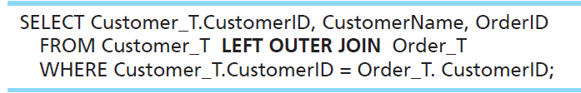
Outer-Join Example
List the customer name, I D number, and order number for all customers. Include customer information even for customers that do not have an order.
LEFT OUTER JOIN clause causes rows from the first mentioned table (customer) to appear even if there is no corresponding order data.
Unlike an INNER join, this will include customer rows with no matching order rows.
For the tables in figure 6.1, this will return 16 rows. That’s because there are 15 customers, and one of these customers has 2 orders.
Notes:
The query:
SELECT Customer_T.CustomerID, CustomerName, OrderID
FROM Customer_T LEFT OUTER JOIN Order_T
WHERE Customer_T.CustomerID = Order_T. CustomerID;

Slide 11
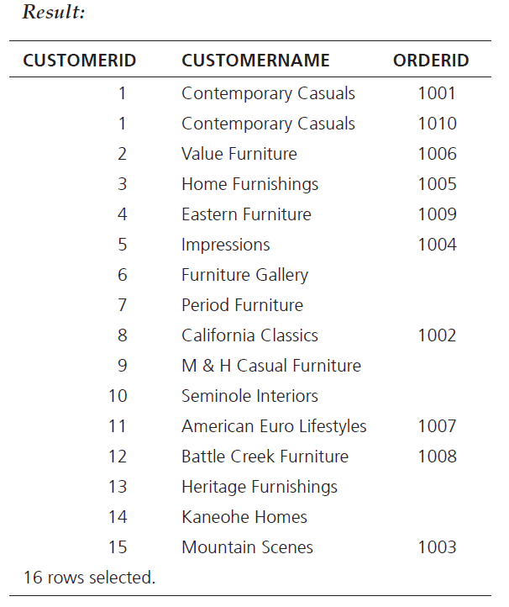
Result
Note two rows for customer #1 Contemporary Casuals.
Also note that several customers don’t have orders.
This is because of the left outer join.
Notes:
Result:
CUSTOMERID CUSTOMERNAME ORDERID
1 Contemporary Casuals 1001
1 Contemporary Casuals 1010
2 Value Furniture 1006
3 Home Furnishings 1005
4 Eastern Furniture 1009
5 Impressions 1004
6 Furniture Gallery
7 Period Furniture
8 California Classics 1002
9 M & H Casual Furniture
10 Seminole Interiors
11 American Euro Lifestyles 1007
12 Battle Creek Furniture 1008
13 Heritage Furnishings
14 Kaneohe Homes
15 Mountain Scenes 1003
16 rows selected.

Slide 12
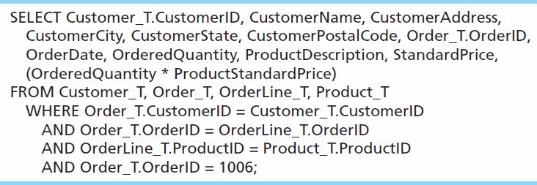
Multiple Table Join Example
Assemble all information necessary to create an invoice for order number 1006.
Each pair of tables requires an equality-check condition in the WHERE clause, matching primary keys against foreign keys.
Notes:
There are four tables involved in this join. Therefore there are three join conditions. In general, if there are n tables, there will be n-1 join conditions.
The final condition (OrderID = 1006) is not a join condition. This is a condition that restricts the number of rows returned, not one that connects tables.
This is why the join syntax (inner join, outer join, etc.) may be preferable. Using that syntax, join conditions are clearly distinguished from other conditions.

Slide 13
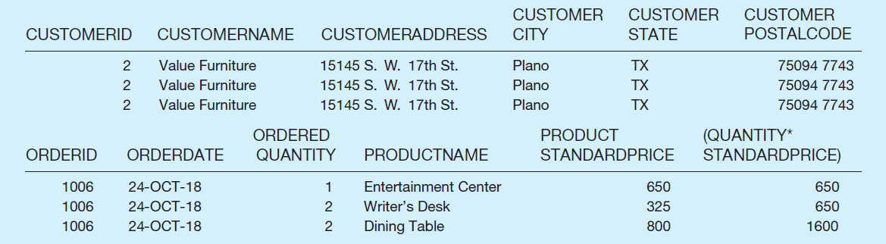
Figure 6-4 Results from a Four-Table Join (Edited for Readability)
All rows returned from this query will pertain to Order I D 1006.
Note that the full query results include columns from four different tables.
Notes:
CUSTOMERID
2
2
2
CUSTOMERNAME
Value Furniture
Value Furniture
Value Furniture
CUSTOMERADDRESS
15145 S. W. 17th St.
15145 S. W. 17th St.
15145 S. W. 17th St.
CUSTOMER
CITY
Plano
Plano
Plano
CUSTOMER
STATE
TX
TX
TX
CUSTOMER
POSTALCODE
75094 7743
75094 7743
75094 7743
ORDERID
1006
1006
1006
ORDERDATE
24-OCT-18
24-OCT-18
24-OCT-18
ORDERED
QUANTITY
1
2
2
PRODUCTNAME
Entertainment Center
Writer’s Desk
Dining Table
PRODUCT
STANDARDPRICE
650
325
800
(QUANTITY*
STANDARDPRICE)
650
650
1600

Slide 14
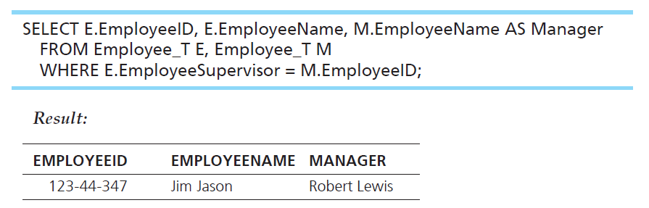
Self Join Example
What are the employee ID and name of each employee and the name of his or her supervisor (label the supervisor’s name Manager)?
The same table is used on both sides of the join; distinguished using table aliases. See the next slide for details.

Slide 15
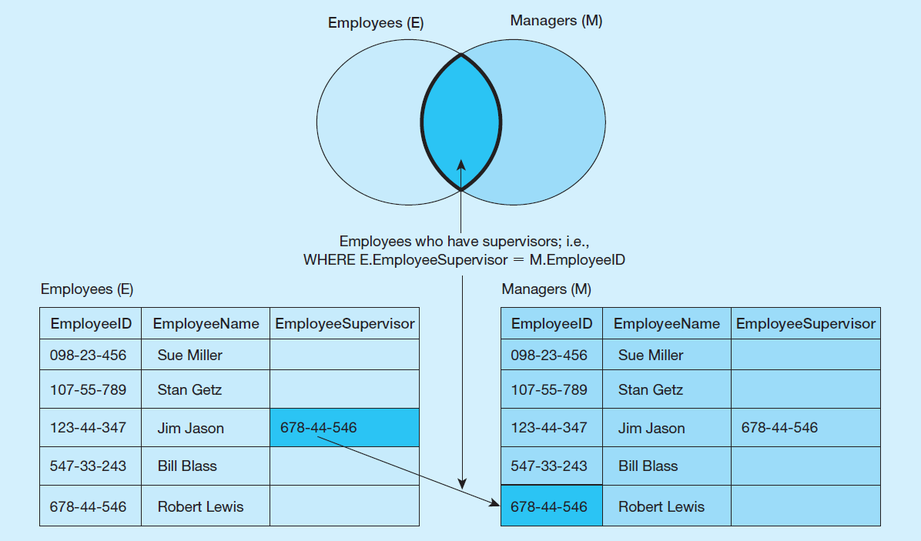
Figure 6-5 Example of a Self Join
Self join involve tables that implement 1-to-many unary relationships.
Notes:
Suppose you have a table of five employees as shown here. Only one of these employees has a supervisor. The EmployeeSupervisor column would be a foreign key in the Employees table which is associated with the primary key EmployeeID. We saw an E-R diagram showing the same sort of thing in Chapter 2. So, a self join is associated with a unary relationship.

Slide 16
Subqueries
Subquery – placing an inner query (SELECT statement) inside an outer query
Options:
In a condition of the WHERE clause
As a “table” of the FROM clause
Returning a field for the SELECT clause
Within the HAVING clause
Subqueries can be:
Noncorrelated – executed once for the entire outer query
Correlated – executed once for each row returned by the outer query
Notes:
Subqueries are usually placed in the WHERE or HAVING clause of the outer query. In this case, the subquery’s results are used to test a condition for the outer query’s WHERE or HAVING clause. If the condition is a test comparing the subquery result to another value, then the subquery should return a single value (one row consisting of one column). If it is used in an IN test or an ALL test of a WHERE clause, it can return a list of values (multiple rows, each with one column). If used in an EXISTS test, there is no limit to the rows and columns returned from the subquery.
It is also possible to put subqueries in the FROM clause of an outer query, instead of a table. In this case there is no restriction on how many rows or columns should be returned from the subquery, but the subquery’s columns must be consistent with the columns in the SELECT clause of the outer query.
If a subquery is used in the SELECT clause, the subquery’s result should be a single value, and this value becomes a column of the outer query.
When using multiple tables, sometimes you need a subquery, sometimes you need a join. Other times, the problem can be solved by either a subquery or a join. It is also possible to combine joins and subqueries together.

Slide 17
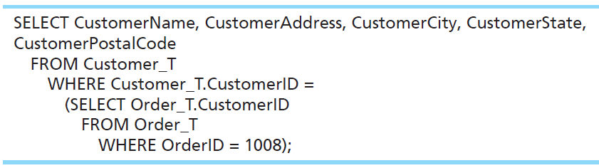
Subquery Example
What are the name and address of the customer who placed order number 1008?
Notes:
First, the subquery returns customer ID for the OrderID 1008. That value is then used in the WHERE condition of the outer query. Note: Since the WHERE clause is testing for equality, the subquery must return a single row with a single column.
Note that a subquery is embedded between parentheses.
The query:
SELECT CustomerName, CustomerAddress, CustomerCity, CustomerState,
CustomerPostalCode
FROM Customer_T
WHERE Customer_T.CustomerID =
(SELECT Order_T.CustomerID
FROM Order_T
WHERE OrderID = 1008);

Slide 18
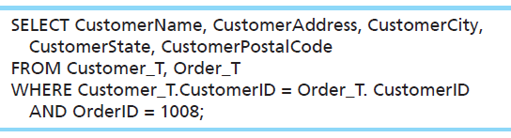
Alternative Approach, Using a Join
What are the name and address of the customer who placed order number 1008?
Notes:
Sometimes you can accomplish the same result in different ways. The previous subquery could have been done via this join.
The join query:
SELECT CustomerName, CustomerAddress, CustomerCity,
CustomerState, CustomerPostalCode
FROM Customer_T, Order_T
WHERE Customer_T.CustomerID = Order_T. CustomerID
AND OrderID = 1008;

Slide 19
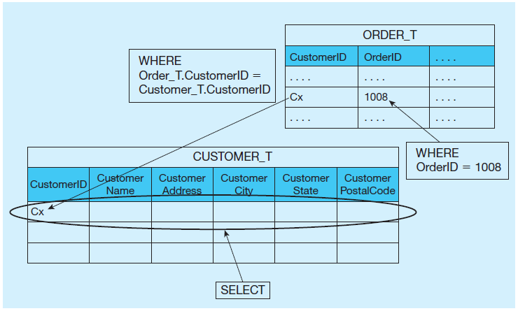
Figure 6-6 Graphical Depiction of Two Ways to Answer a Query with Different Types of Joins (1 of 2)
a) Join query approach
Notes:
The joining technique is useful when data from several relations are to be retrieved and displayed, and the relationships are not necessarily nested, whereas the subquery technique allows you to display data from only the tables mentioned in the outer query. For example with the join we could see the OrderID, but not with the subquery.
A join involves a cross product which combines all combinations of rows from each of the tables, followed by removing the rows that don’t match according to the conditions of the join.

Slide 20
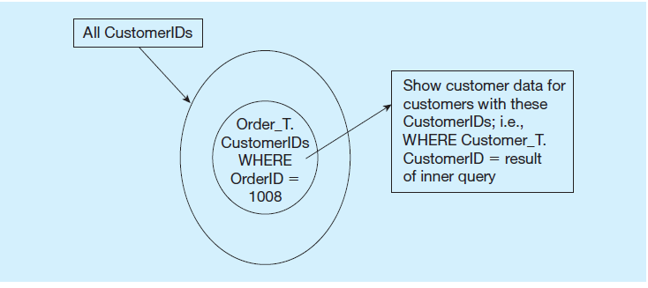
Figure 6-6 Graphical Depiction of Two Ways to Answer a Query with Different Types of Joins (2 of 2)
b) Subquery approach
Notes:
A subquery operates differently from a join. First, the subquery executes, which returns a result. Then that result is used in the outer query.
So, for these examples, although the results are the same, the execution that gave the results are quite different.

Slide 21
Correlated versus. Noncorrelated Subqueries
Noncorrelated subqueries:
Do not depend on data from the outer query
Execute once for the entire outer query
Correlated subqueries:
Make use of data from the outer query
Execute once for each row of the outer query
Can use the EXISTS and ALL operators
Notes:
Correlated subqueries use the result of the outer query to determine the processing of the inner query. That is, the inner query is somewhat different for each row referenced in the outer query. In this case, the inner query must be computed for each row processed in the outer query, whereas in the earlier examples, the inner query was computed only once for all rows processed in the outer query.

Slide 22
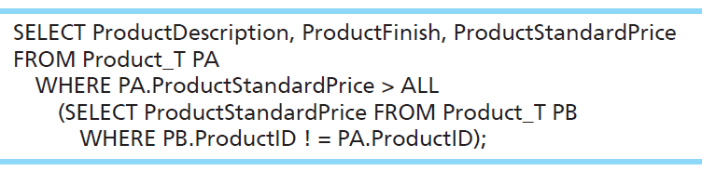
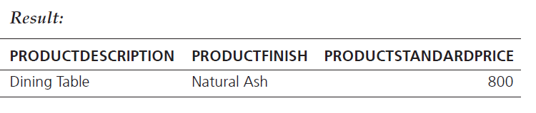
Example of a Correlated Subquery
List the details about the product with the highest standard price.
Notes:
Note that the outer query uses Product_T with a PA alias in its FROM clause. The subquery also uses Product_T in its FROM clause but with a PB alias.
The subquery also references the PA alias from the outer query, which makes the subquery correlated.
Query:
SELECT ProductDescription, ProductFinish, ProductStandardPrice
FROM Product_T PA
WHERE PA.ProductStandardPrice > ALL
(SELECT ProductStandardPrice FROM Product_T PB
WHERE PB.ProductID ! = PA.ProductID);
Result:
PRODUCTDESCRIPTION PRODUCTFINISH PRODUCTSTANDARDPRICE
Dining Table Natural Ash 800

Slide 23
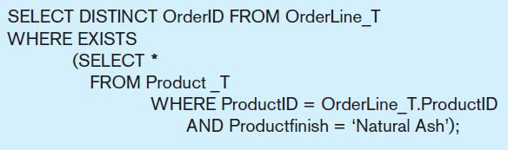
Another Correlated Subquery
What are the order I Ds for all orders that have included furniture finished in natural ash?
A correlated subquery always refers to an attribute from a table referenced in the outer query.
Notes:
The key feature that identifies a correlated subquery is the fact that the subquery makes reference to a column from the outer query. Note that OrderLine_T is a table used in the FROM clause of the outer query, but is not a table in the FROM clause of the inner query. Yet, the WHERE clause of the inner query does refer to a column from OrderLine_T, specifically the ProductID.
If your subquery has a reference to a table in the outer query, that makes it a correlated subquery. If it does not have such a reference, then it is a noncorrelated subquery. Here, the subquery is testing for a value that comes from rows processed in the outer query. Specifically, the OrderLine_T table, which is in the FROM clause of the outer query, but not the subquery.
The EXISTS operator will return a TRUE value if the subquery resulted in a non-empty set, otherwise it returns a FALSE.

Slide 24

Copyright

